Slide 1
Recent African Debt Vulnerabilities and Challenges for Monetary Policy
By Professor Benno J. Ndulu
(with acknowledgement of Prof. Stephen O’Connell – Co author of Parent Paper)

Slide 2
Outline of the Presentation
Recent major changes in the level and Composition of African Debt
What Explains theses Changes?
What are the key risks to be managed in the Near and Medium Term?
How could African Central Banks respond to these challenges?
Protecting Central Bank independence/autonomy
Debt Sustainability – Enforcing prudential rules for debt accumulation

Slide 3
The Rising African Debt Challenge And Vulnerabilities

Slide 4
Recent Trends in African Indebtedness
SSA’s debt accumulation over the period since the global financial crisis followed a period of declining debt that accompanied deep debt-stock relief from official creditors in the HIPC and MDRI campaigns.
The average ratio of public debt to GDP ratio in SSA has since risen by a quarter from about 30% in 2012 to 37.8% in 2017 (23% in PV terms against a threshold even of poor governance of 30%)
Africa is not alone in its recent surge in debt, suggesting the importance of common global drivers

Slide 5
Recent
Notes:
The increase in SSA public debt has been commented on widely. This figure shows external debt/GDP, but domestic debt has also increased as a share of GDP. Among African countries who report to the new World Bank/IMF Quarterly Debt database, domestic debt is quite large – 40-50 percent of total public debt for Uganda and Cote d’Ivoire and above 60 percent for 3 of the 4 non-HIPCs (Kenya is 47 percent).
Africa is certainly not alone in its recent surge in debt, suggesting the importance of common global drivers including very low interest rates and countercyclical responses to the global financial crisis and so-called Great Recession.

Slide 6
African Debt Episode in a long Term Perspective
Three distinct phases emerge.
The first runs from 1980 to the mid-1990s - phase of economic stagnation and mounting debt problems - growth of debt outpaces that of exports and GDP. Internally -
The second phase runs from mid 1990s to the peak of the global financial crisis in 2010 - debt Debt-to-GDP and Debt-to-export ratios are falling through a combination of debt cancellation, strong growth in GDP and export revenues facilitated by a long boom in the primary commodity prices.
The third phase runs to the current period with rising debt-GDP ratio and debt-export –ratio resulting from a combination rapid accumulation of new debt enabled by enhanced creditworthiness (from debt relief and good policy /growth) and very low interest rates due to QE; global recession, and fall of commodity prices
At the peak in 1995 SSA External Debt to GDP ratio was 115%, reached a bottom of 30% in 2012 before rising to the 2017 level of about 38.7% (23% in Present value terms in 2017).
It has since 2017 plateaued and indications are that the ratios will decline with projected revival of growth and halt in the decline of commodity price (WEO). In terms of levels, ratios in SSA lower than in other regions.

Slide 7
2/3
2017 SSA Averages:
PV(debt)/GDP = 23%23% [30%]
PV(debt)/Exports = 97% [140%]
[LIC DSA High risk threshold assuming Weak governance]
Notes:
The present value of external debt/GDP = 23% in 2107. The debt thresholds for Weak, Neutral and Strong governance ratings in the Bank/Fund LIC DSF are 30, 40 and 55 percent

Slide 9
Key Differences Between The 1980s Debt Crisis and Current
Similar Drivers but very different macroeconomic situations

Slide 12
Emerging and Rapidly Rising Public Debt Burden
Figure below provides a sense of the rapid build up of debt servicing burden on domestic revenue. It shows that between 2013 and 2017, the debt service burden for the majority of countries have accelerated (above the 45degree line).
The next table shows a rising proportion of countries at high risk or in debt distress already.
Maturity Bunching around 2023 poses a potential debt servicing crisis in the absence of of successful restructuring or adequate sinking Fund

Slide 13
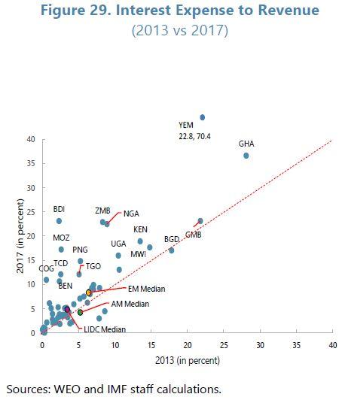
Notes:
Most countries suffered more significantly from debt service vulnerabilities than debt stock vulnerabilities

Slide 14
Rapid Transitions into High Risk of Debt Distress
In 2013 out of 39 African low income countries
12 were categorized with low risk of debt distress
18 with moderate risk
10 with high risk and none under distress
By 2018
Only 4 remained at low risk of debt distress
17 were at moderate risk
12 were in high risk of distress (of which 8 were categorized fragile states or in conflict)
6 in Distress (of which 5 were categorized as fragile states or in conflict)
Out of the 12 previously with low risk 6 transited to moderate and 3 to high risk
Out of 18 previously with moderate risk 1 improved to low risk, 5 worsened to high risk and 3 to distress
Out of 9 previously in High risk 2 improved to moderate and 3 worsened to distress

Slide 15
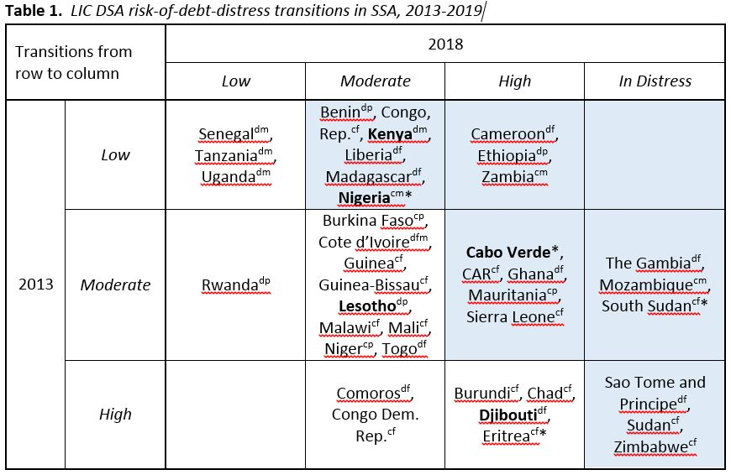
2/2
d = diversified exporter
c = commodity exporter
m = frontier market
f = fragile or conflict-affected
p = pre-emerging
Non-HIPC countries in bold.
Source: IMF (2018), World Bank (2018), Joint IMF/WB LIC DSA list May 2019
Notes:
Deteriorations in debt sustainability since 2013 are widespread, across commodity exporters and diversified exporters, frontier markets and pre-emerging (“developing”) markets, and fragile and non-fragile states.
The diversified exporters have done better than the commodity exporters and the non-fragile states have done better than the fragile states.
There have been only 3 improvements over that period: Rwanda went from Moderate risk to Low risk and Comoros and DRC went from High to Moderate.

Slide 16
Two Important Distinguishing Compositional features of Recent African Debt
One, debt has increasingly been acquired from non-concessional sources at higher cost and shorter maturity.
Commercial debt has increased from 2.7% to 5.6% of GDP(doubled) and
domestic debt at market rates has increased from 10.8% of GDP to 15.8%.
And for 8 SSA post HIPC countries in debt difficulties commercial external debt increased from 4.9% to 15.3% while domestic debt increased from 12% to 18.7%.
Two, the composition of creditors is also hugely different.
the share of Paris Club debt declined sharply from 7.4% of GDP in 2007 to 2.2% in 2016;
Bilateral debt from China increased from 0.3% to 4.2% of GDP (14-fold) in the same period; and
For 8 SSA Post-HIPC countries in Debt difficulties the change was more pronounced – Paris Club down from 8% to 2.8%; bilateral from China increased from 0.2% to 11.6%. (table

Slide 17
Major Implications of Compositional Changes
These compositional changes imply that
on the one hand, the external position of many African countries is more exposed to changes in global interest rates and financial market sentiment than it was two decades ago (per dollar of external debt), and
on the other that new issues of creditor coordination will have to be navigated in order to secure protective debt restructurings and handle payments crises.

Slide 18
Key Drivers
When explaining these trends, it is important to keep in mind four key influential factors: greater ability to borrow, increased financing needs, fragility, and moral hazard from deep irrevocable debt relief (HIPC,MDRI) .
(1) A greater ability to borrow has resulted from
massive irrevocable debt relief which 33 African countries received under the HIPC and MDRI programs;
improved fundamentals partly buttressed by reform programs with key multi-lateral institutions and
favourable global financial conditions – QE
(2) A greater need of financing is partly reflected by
the drive to fill the huge infrastructure gap constraining growth and the achievement of the ambitious MDG targets,
particularly those related to human capital and welfare;
and the and financing of counter cyclical action which arose from negative terms of trade shocks which not only weighed on growth and government revenue, but also led to a rise in government contingent liabilities ( BIS 2018, p. --; Christensen 2016).

Slide 19
Key Drivers
(3) Thirdly is to deal with risks from fragility of economies in terms of civil strife, susceptibility to natural disasters and dependency on volatile commodity market.
It appears that being either a small island economy or a Fragile state (in terms of conflict or natural disasters) or a predominantly commodity exporter puts a country at high or moderate risk of debt
All small island economies, more than 90% of Fragile Countries, and more than 85% of commodity exporters are classified either at high or moderate risk – WB 2019, IDA paper on Debt vulnerability
(4) Moral Hazard from irrevocable debt relief (elaborated next slide)

Slide 20
Was Debt Relief Futile?
Easterly’s two-fold argument
HIPC debt relief would be wasted if the policy environment for growth did not change,
and that there was little basis to expect it to change. – instead a wealth windfall from debt relief and high discount rate (impatience for consumption) would spur a consumption boom and a debt unsustainability spiral.
What is clear in retrospect is that
the policy environment for growth in SSA improved immensely both before and during the HIPC/MDRI period. (Easterly 2018, CPIA scores trends for evidence)
Consumption boom did not emerge – growth in recurrent expenditure largely driven by MDG spending mainly in health and education (human capital)
Two investment booms (particularly in HIPC countries) pre-MDRI largely driven by national savings and post MDRI financed by both national savings and debt
Djimeu (2018) finds large and statistically significant contribution of the HIPC Initiative to public investment and also to growth.
Cassimon et al (2015) findBoth initiatives led to increased revenue collection consistent with debt overhang effects but MDRI also led to increased current spending associated with MDGs

Slide 21
Decomposing Sources of Changes in Debt Ratio
Domestic real interest rate (measured in domestic goods), can be written as
$$r_{t}=i_{t}+{\hat{e}}_{t}−π_{t},$$
the sum of foreign real interest rate $i_{t}$(measured in foreign goods) and the rate of real depreciation of the local currency (${\hat{e}}_{t}−π_{t}$)
$\left(r_{t}=r_{t}^{∗}+{\hat{rer}}_{t}\right),$ implies that the change in the ratio of public debt to GDP can be decomposed into the contributions of
the primary deficit, (accumulation increases with primary deficit)
real exchange rate depreciation, (In the short run depreciation increases debt ratio because of stickiness, and in the long term it reduces it via improved exports)
real GDP growth, (reduces debt ratio)
the real interest rate (relates inversely with debt ratios via influencing cost of borrowing)
a residual

Slide 22
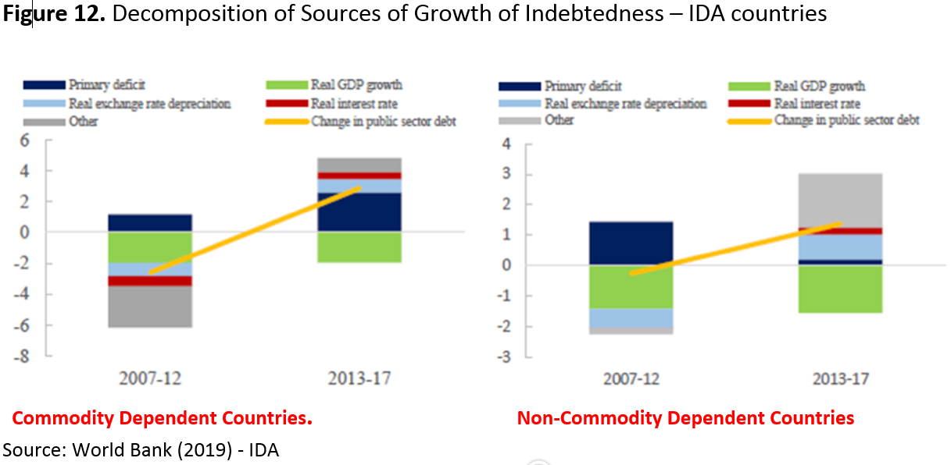

Slide 23
Transmission Channels to Monetary Policy
Two key channels of transmission of pressures from debt distress to monetary policy
exchange rate for external debt (to keep servicing costs in local currency down – provide relief to primary deficit)
interest rate for domestic debt ( pressure to lower interest rates to keep rollover or servicing cost down and hence provide relief to primary deficit; or lower borrowing costs for capital budget)

Slide 24
EMERGING Debt-Related Macroeconomic RISKS

Slide 25
Heightened Macroeconomic Risks Putting National Assets at Risk
Distress from increased debt service requirements or restricted access to new credit endangers the newly rebuilt assets (physical, human and policy environment) – as it happened in the 1980s [Development Assets at Risk]
Starving budgets of capital expenditures (easiest to cut politically than wages etc)
Starving infrastructure of maintenance and operational expenditures reducing service and quality of the assets
Deterioration in policy environment, including inflation, as attempts to monetize deficits are made
Pressure on suppressing exchange rate and interest rate adjustments - required for prudent monetary policy – in order to keep the cost of debt service or rollover low.
Risk of Default and closure of access to new credit
Perhaps even more worrisome is being unable to complete large infrastructure projects due to failure of raising new debt (WHITE ELEPHANTS)

Slide 26
Key Risk Drivers
Maturity Mismatches – shorter term debt financing long gestation infrastructure investments
Debt obligations are maturing ahead of the revenue streams from the infrastructure investments (physical and social) they financed putting pressure on resource envelope for servicing debt
Rollover Risks
With end of QE interest rates are rising, increasing the cost of rolling over existing debt. In almost all countries now interest rates exceed growth pointing to rising distress.
Maturity bunching mainly around 2020 and 2023 enhances risk of default in the absence of negotiated deal
Coordination challenges in Debt resolution –
Issues of creditor coordination are arguably more daunting now than they were the mid-1990s, reflecting the increasing importance of private creditors and the emergence of China
In some cases Currency mismatches –
since infrastructure and human capital produce largely revenue streams in local currency, there may be a challenge in externalization of debt service payment (as happened in the past) generating arrears and growing the stock of unpaid debt with the attendant penalties. This was a significant source of the growth of debt stock in the past.

Slide 27
Heightened Rollover Risks: End of Quantitative Easing and Rise in interest Rates
USA is already moving full steam to reversal while Europe is winding down QE. Two major impacts are worrisome vis a vis macrostability
Reversal of capital flows back to USA and Europe to take advantage of higher returns and reduced risks – likely to engender
significant pressures on and volatility of exchange rate and
tightening of liquidity particularly if foreign currency denominated deposits decline and subdues liquidity injection via inflows of foreign savings
Initial large negative effect on central bank income via revaluation losses as price of its foreign assets decline with rise in interest rate - engendering inadequacy of capital and threat to central bank independence.

Slide 28
Some Ideas for Managing Risks

Slide 29
Pursue Prudential Debt Management
Keeping the National Balance Sheet – Balanced
Avoid borrowing for consumption
For intergenerational equity Debt should add to national asset build up (physical and human capital) to the same level it adds to national liabilities
Government borrowing that accompanies an economic or social infrastructure surge would be viewed as sustainable if the new infrastructure were self-financing (revenue should be more than sufficient to maintain and operate the new capital and service the additional debt).
Dynamic rule – In accumulating new debt the cost of new borrowing – (real interest rate) should not exceed real growth rate of the economy
Establish Debt Service Sinking Fund to deal with the challenge of maturity bunching
while pursuing restructuring that deals with maturity mismatches (Examples of Ethiopia, Kenya, Nigeria, Ghana)

Slide 30
Protecting Central Bank Independence/Autonomy
Push back on pressures to fixing interest rates and exchange rates
Need flexibility of both to broaden scope of adjustment to shocks and for maintenance of macroeconomic stability
Capital Adequacy of Central Banks pivotal for avoiding recourse to budgetary financing of monetary operations
Ultimately it is key to enshrine Central Bank Autonomy with associated Accountability and Transparency in respected Constitutions

