Slide 1
“ Debrief on Current Regional Payment System Infrastructures or Initiatives on the Continent: Case of the Common Market of Eastern and Southern African (COMESA)”

Slide 2
COMESA AT A GLANCE
TOTAL AREA 12.8 MILLION SQ KM
POPULATION 520 MILLION
MEMBERSHIP 21 COUNTRIES
FTA MEMBERSHIP 16 COUNTRIES
INTRA-COMESA TRADE $ 16.1 BILLION (2017)

Slide 3
COMESA MEMBERSHIP

Slide 4
COMESA INSTITUTIONS
TRADE AND DEVELOPMENT BANK
COMESA CLEARING HOUSE
COMESA COURT OF JUSTICE
THE COMESA RE-INSURANCE COMPANY (ZEP-RE)
AFRICAN TRADE INSURANCE AGENCY OFFERS POLITICAL RISK GUARANTEE
LEATHER AND LEATHER PRODUCTS INSTITUTE
COMESA REGIONAL INVESTMENT AGENCY
COMESA FUND
COMESA MONETARY INSTITUTE

Slide 5
INTRA-COMESA TRADE BY COUNTRY 2016-2017 (USD MILLIONS)

Slide 6
BACKGROUND
The COMESA Clearing House (CCH) - established in 1984 (as the PTA Clearing House)
Facilitation of the settlement of trade and services payments amongst Member States
Liberalisation of markets – CCH had to restructure its services to be more relevant

Slide 7
BACKGROUND cont..
Mandated to design and implement a Payments System - to reduce costs of regional transactions in a liberalised foreign exchange regime.
The Regional Payment and Settlement System (REPSS), was designed by COMESA Central Banks Payments Experts, with inputs from the IMF and financial institutions of the region and with financial support from the EU.

Slide 8
COMESA CLEARING HOUSE REGIONAL PAYMENT & SETTLEMENT SYSTEM (REPSS)

Slide 9
REPSS OBJECTIVES
Stimulate economic growth through an increase IN intra-regional trade
Reduce cost and duration of cross border transactions
Homegrown solution, operated by the COMESA countries
System IS reliable, secure and predictable
Low investment and operational costs
Settlement in hard currencies ($,€)

Slide 10
REPSS features
System is centrally located
Local banks to access system through central banks
Payment System linking central banks
Payments to be effected through clearing (not real time)
Principle of credit push (pre-funded aCcOUNT)
Compliant with BIS core principles

Slide 11
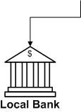
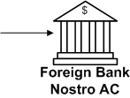
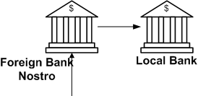
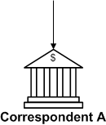
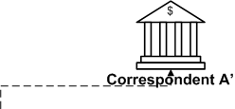
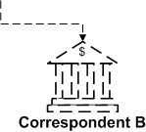
Traditional Cross Border Payment
T r a d e

Slide 12
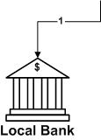
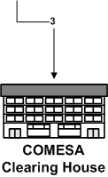
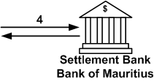
REPSS Model
T r a d e
T+0
T+1
T+0
REPSS

Slide 13
BENEFITS
REDUCES NUMBER OF SETTLEMENT TRANSACTIONS
REDUCES FOREIGN CORRESPONDENT BANKING CHARGES
REDUCES COST OF INTRA-REGIONAL TRADE
REDUCES SETTLEMENT TIME PERIOD
GUARANTEES PROMPT PAYMENT TO EXPORTER
BUILDS TRUST AMONG TRADERS
SETTLEMENT FINALITY
LEVELS PLAYING FIELD FOR COMMERCIAL BANKS
EVENTUALLY ALLOWS TRADE ON OPEN ACCOUNT

Slide 14
ROLES AND RESPONSIBILITIES
ROLE OF CCH
PROVIDE THE PAYMENT AND SETTLEMENT SERVICES TO THE PARTICIPANT
ENSURE THE ON-GOING STABILITY, OPERATIONAL CAPABILITY AND EFFICIENCY OF REPSS
DISCHARGE AND CLEAR THE BANK’S PAYMENT OBLIGATIONS TO OTHER PARTICIPANTS

Slide 15
ROLE OF SETTLEMENT BANK
HOLD ACCOUNTS OF THE PARTICIPANTS IN ITS BOOKS
CARRY OUT SETTLEMENT SERVICES FOR REPSS
SEND END OF DAY SETTLEMENT REPORTS TO PARTICIPANTS
NOTIFY CCH ABOUT CHANGES IN THE BALANCES OF PARTICIPANTS
CARRY OUT FUND TRANSFER TO/ON BEHALF OF THE PARTICIPANTS
SEND DAILY/MONTHLY STATEMENTS TO PARTICIPANTS

Slide 16
ROLE OF PARTICIPANT
SEND PAYMENTS TO REPSS FROM COMMERCIAL BANKS
PRESERVE AND ASSURE THE PRIVACY AND CONFIDENTIALITY OF THE DATA AND INFORMATION RELATED TO TRANSACTIONS
PROVIDE INFORMATION TO CCH FOR THE SMOOTH DAY TO DAY RUNNING OF REPSS.
ENSURE THAT THEIR ACCOUNTS ARE ADEQUATELY FUNDED PRIOR TO SENDING PAYMENTS
ENSURE THAT REPSS OPERATIONS ARE NOT DELAYED

Slide 17
LEGAL FOUNDATION
JURISDICTION
COMESA COURT OF JUSTICE
AGREEMENT BETWEEN BOM AND CCH
AGREEMENT BETWEEN CCH AND PARTICIPANT
AGREEMENT BETWEEN BOM AND PARTICIPANT

Slide 18
COMESA HEADS OF STATE AND GOVERNMENT SUPPORT TO REPSS
COMESA Heads of State and Government have:
Highly commended COMESA Central Bank Governors for the setting up REPSS, which will greatly assist in expanding Intra-Regional Trade;
Urged other Central Banks to expedite their going live on REPSS and aggressively promote this facility; and
Urged all commercial banks and stakeholders to make full use of the system for the benefit of our economies and the region at large.

Slide 19
CURRENT STATUS OF REPSS
9 Countries are live on repss: EGYPT, DRC, kenya, malawi, mauritius, rwanda, eSwatini, Uganda and Zambia
Transactions on repss in 2018 – over usd44 million, and nearly usd13 million jan – mar 2019
More central banks joining repss and with Increased intra comesa trade – greater use of repss and more trade.

