Slide 1
Presentation on interoperability approach adopted in SADC
SADC Low value Credit Transfers Cleared on an Immediate Basis (TCIB)

Slide 2
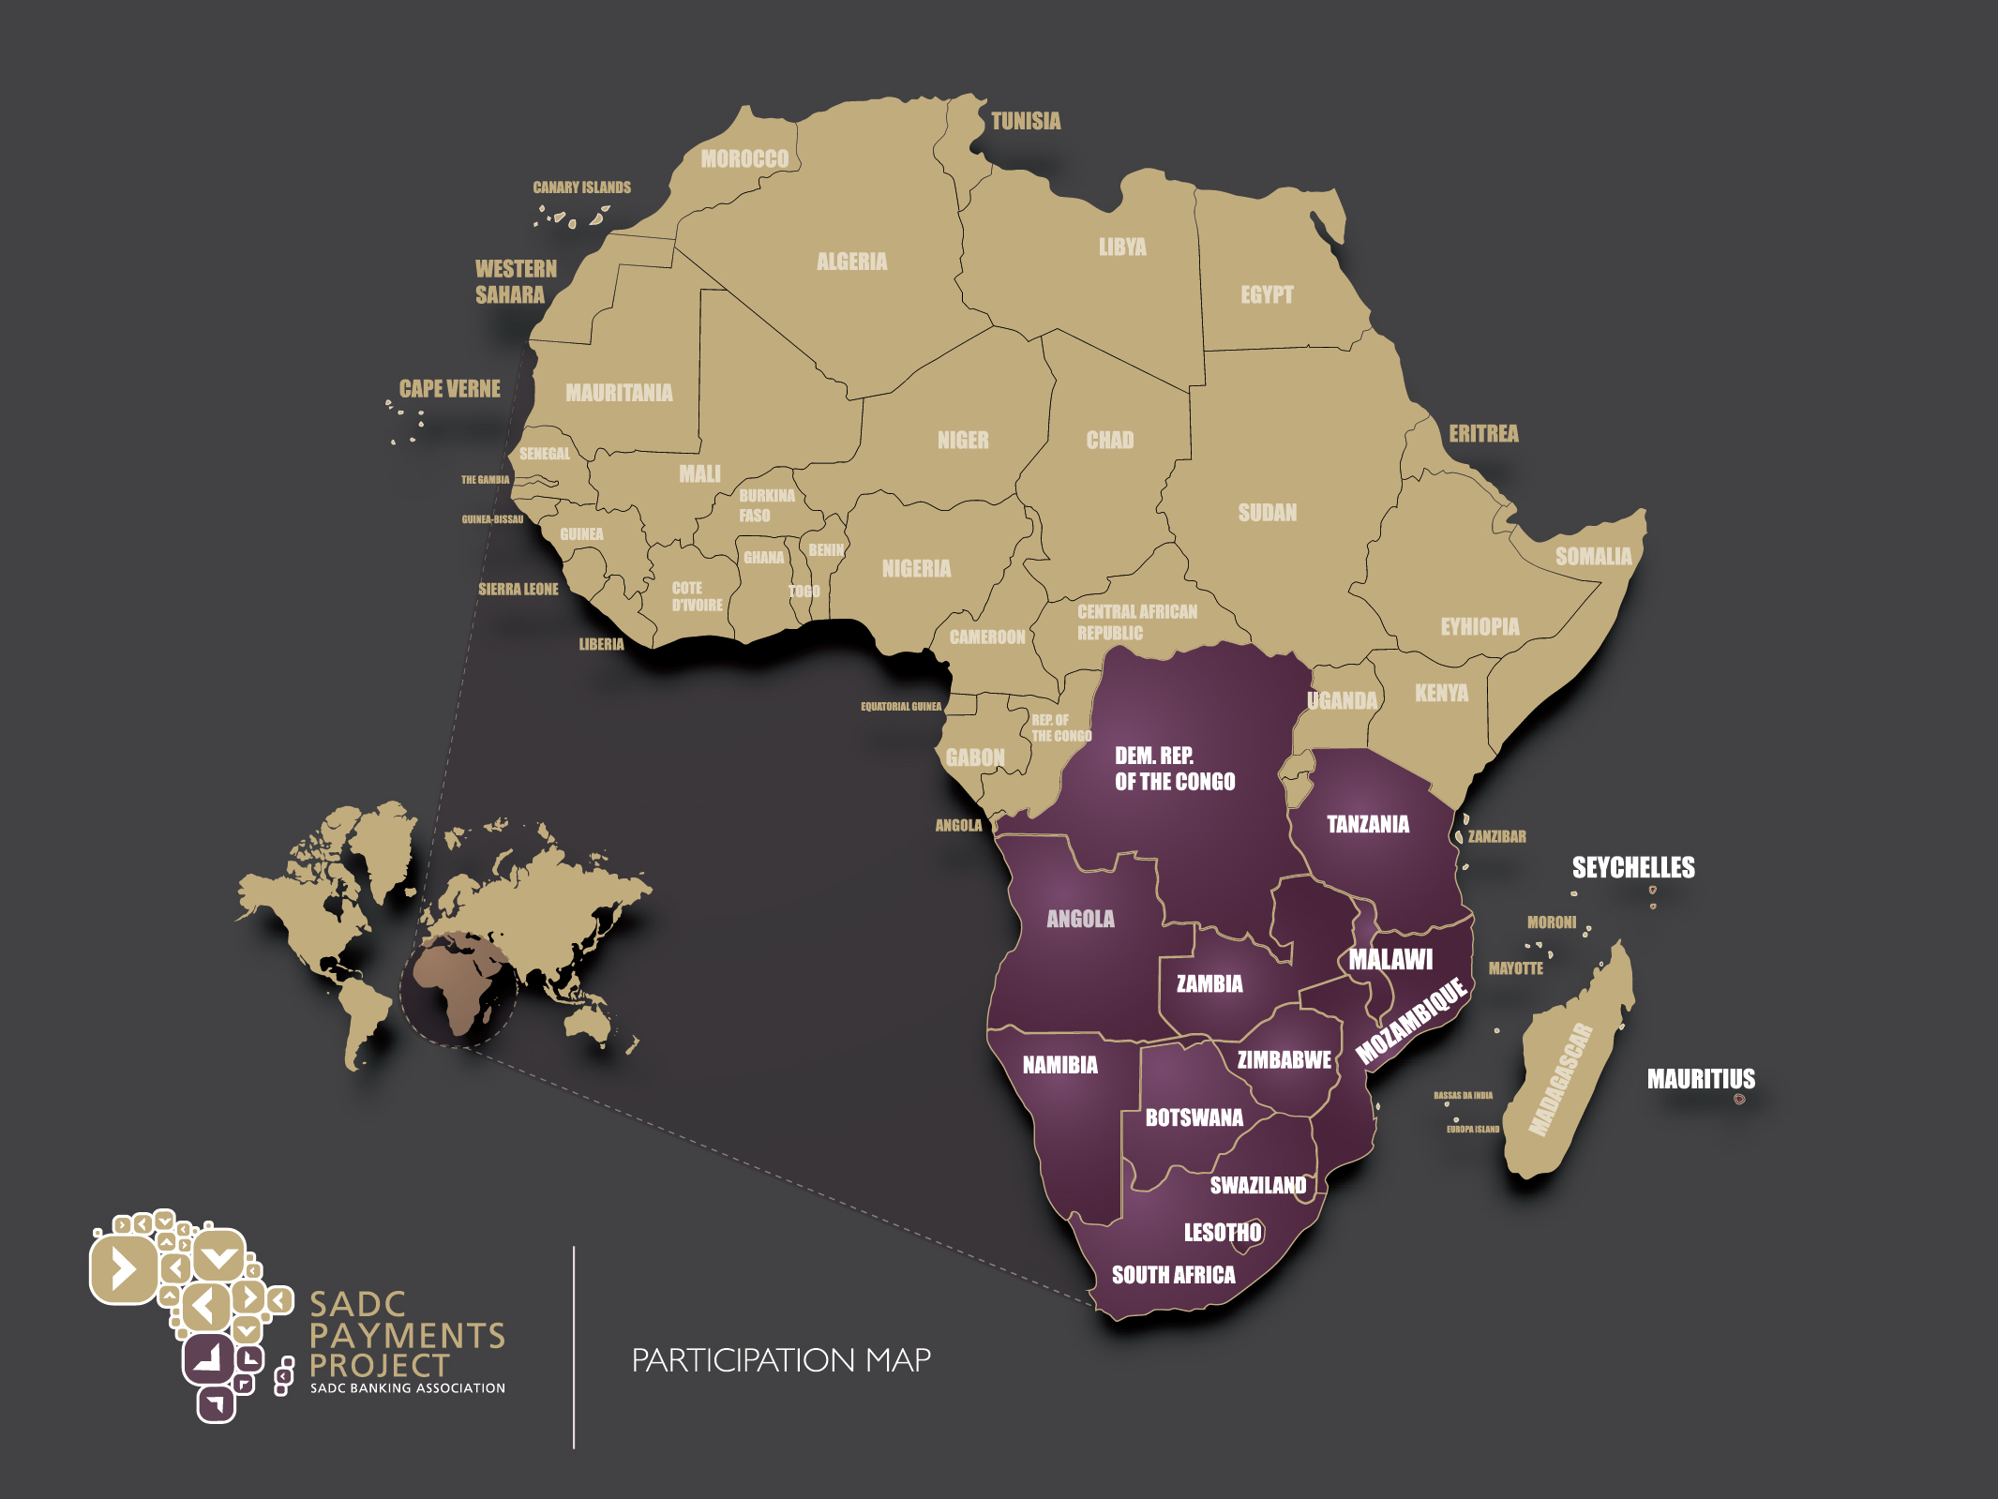

Slide 3
SADC Payments Project
Project driven under the SADC Finance and Investment Protocol
Governed at the Committee of Central Bank Governors
SADC Banking Association mandated to develop the various payment schemes and interface with the central bank settlement systems
In order to increase financial inclusion in the region non-banks have also been brought to the table in order to develop suitable solutions for end clients

Slide 4
SADC TCIB Regulatory Eco System
Central Bank PSOC
Central Bank
Central Bank
SADC-RTGS
Authorises participation
Authorises participation
Rules
Operator
Non-bank
Authorised based on CPFI/IOSCO Standards
Non-bank
Country A
Country B
Normal Low Value Credit Transfer
Participants to adhere to the AML, KYC, BoP reporting requirements etc. of own regulator. These have been harmonised as far as possible.

Slide 5
Started with the operating model
Needed to include all eligible participants
Needed to ensure use of existing intra-country settlement mechanisms
Needed to reuse existing infrastructure where possible
Needed to consider regulatory requirements

Slide 6
SADC Low Value Credit Transfers Cleared on an immediate basis via a RCSO operating model
Bank can have various roles;
-Send own payments
-Manages Trust account
-Settlement Bank
-Nostro settlement bank for non-SIRESS currencies
-FX provider
SADC RTGS
RTGS being a multi-currency settlement system
Advices of DR or CR
Daily
Settlement
Direct or via local ACH
Direct or via
Local ACH
Bank
Regional
CSO
Bank
Direct or via PPSP
Non-bank
For CICO
SMS Notifications/exchange of payment detail
Non-bank
For
CICO
Agent
Interoperability Agreement
Agent
PPSP = message switch – FX provider –AML/KYC - operations

Slide 7
Transfers in non-SIRESS currencies Cleared and Settled via correspondent banks through a RCSO
Here we would like to interface directly with Central Bank RTGS systems for settlements in any African currency
High level model
Settlement Bank of non-bank or own transfers
Normal MT 202 /MT103transfer
Settlement
Bank of
Non-bank or
own
transfers
Bank
Nostro
Account
Bank
Nostro
Account
Settlement figures
Regional
CSO
Bank
Bank
Direct or via PPSP
Non-bank
Non-bank
SMS Notifications/exchange of payment detail
Interoperability Agreement

Slide 8
Transfers in non-SIRESS African currencies
This is what it could look like
WAEMU
EAC
COMESA
High level model
Settlement Bank of non-bank or own transfers
Settlement
Bank of
Non-bank or
own
transfers
Bank
Bank
Regional
CSO
Bank
Bank
Direct or via PPSP
Non-bank
Non-bank
SMS Notifications/exchange of payment detail
Interoperability Agreement

Slide 9
The TCIB Participants
ZAR & USD to come
SADC RTGS
Bank as settlement bank or also a sender/receiver of transfers
RCSO authorised by PSOC/PSMB
Daily
Settlement
Direct or via local ACH
Direct or via
Local ACH
Bank
Regional
CSO
Bank
Direct or via PPSP
Non-bank
For CICO
SMS Notifications/exchange of payment detail
Non-bank
For
CICO
Agent
Interoperability Agreement
Agent
PPSP = message switch – FX provider –AML/KYC - operations
TIGO, Airtel, Mukuru, Hello Paisa etc.
Retail stores
Transfer 2 , TerraPay, MFS

Slide 10
How it works

Slide 11
Non-Bank-to-bank with settlement via SADC-RTGS
Sending of payment and clearing
Step 1
SADC-RTGS
Settlement Bank of Non-Bank
ISO 20022 Pacs 008 001 05
ISO 20022 Pacs 008 001 05
Bank
SADC RCSO
Non-Bank
PSP
Receive payment from RCSO direct or via local ACH

Slide 12
Non-Bank-to- bank with settlement via SADC-RTGS
Step 2
Pre-settlement testing
MT 202 to switch funds from CPL to CPBL account
Settlement Bank of Non-Bank
SADC-RTGS
Advice of debit
Amount to be processed over
SADC-RTGS
Bank
SADC RCSO
Non-Bank
PSP
Advice of credit
Amount to be processed over
SADC-RTGS
Advice of debit amount to be processed over SADC-RTGS

Slide 13
Non-Bank-to- bank with settlement via SADC-RTGS
Step 3
Settlement and post settlement testing
Settlement Bank of Non-Bank
Advice of debit
Advice of credit
SADC-RTGS
Advice of debit
Bank
SADC RCSO
Non-Bank
PSP
RCSO sends settlement instruction to SADC-RTGS

Slide 14
Non-Bank-to- bank with settlement via correspondent banking arrangements
Step 3
Settlement and post settlement
Paying bank sends SWIFT MT 202
to pay the receiving bank
Net Paying Bank
Bank
SADC RCSO
RCSO sends settlement instruction to paying bank

Slide 15
Components of a payment scheme
A payment scheme is more than just a switch and some rules.
It needs to comply with regulatory requirements
The infrastructure to be efficient, safe and secure
It needs to allow for suitable competition but at the lowest cost possible to end clients

Slide 16
Payment scheme entities and roles
1. Payment Scheme Supervision and Regulation Framework
2. Payment Scheme Governing Body
3. Payment Scheme Ownership Body
4. Payment Scheme Rules
5. Payment Scheme Operator
6. Retail Service Provider Participants
7. Payment Platform Service Provider
8. SW, HW, Network Platform
9. SW stack

Slide 17
SADC Aligned Payment scheme entities and roles
1. Payment System Oversight Committee (CCBG)
2. Payments Scheme Mgt. Body (PSMB)
3. TBD – new shareholder association
4. PSMB/ Beige Book
5. SADC-RTGS (settlement) / BankServ (retail)
6. Authorized Banks and non-banks
7. BankServ + outsource partners
8. Multiple,
9. Multiple, proprietary + TBD

Slide 18
Roles explained
PSOC – Central Bank Payment System Oversight Committee with representatives from all countries using the SADC –RTGS
PSMB – Payment Scheme Management Body – Self regulating body with representatives from all SADC countries using the SADC-RTGS
Payment Scheme Ownership Body – an association representing the participants – user group
Rule book – housed in the SADC Beige Book
SADC-RTGS for settlement and RCSO for clearing
Authorised banks and non-banks
Retail payment platform provider
IT platform – insourced/outsourced and networks
Software components

Slide 19
Areas where much work was done
Lots of time, effort and money allowed us to work on the following important aspects;
- Message standards
- Connectivity
- Meeting regulatory requirements
- Commercials
- Pre-settlement risk
- Supporting documentation

Slide 20
Aspects worked out with regulators
Transfers will be settled by banks
Central Banks determine transfer limits
Central Banks set KYC, AML and other regulatory requirements
Operator authorised in terms of CPFI/IOSCO standards
Operator manages limits and rejects transactions exceeding limits
Operating model fully documented
All participants bound by scheme rules
BoP reporting information standardised
SADC PSOC has oversight
Central banks regulate both banks and non-banks and therefore central bank in SADC at other end of the transaction has assurance that all central banks in SADC regulate the same scheme on the same basis

Slide 21
Other aspects of the scheme
Commercials – client facing component out of scope – Operator charges the sender – Pricing fame work document developed to guide participants on how they should handle any charges in the chain.
Supporting documentation - Beige Book covering operating model, rules and regulatory requirements – message schemas and examples – associated documents e.g. SLA’s , claim procedures etc. – operator agreements and specifications etc.

Slide 22
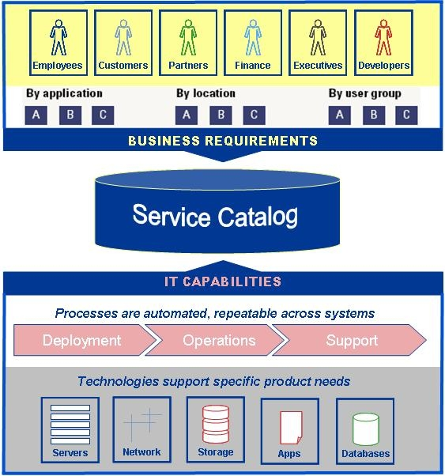
SADC Payment Scheme Documents
Beige Book- operating models, rule books, other information and background
Linked associated documents covering specific agreements, procedures etc.
Operator documents and agreements covering its services
Message schemas and rules as well as message examples

Slide 23
Questions?

